Slide 1
Deep Learning in Video Games
PHAN Benjamin
AUDREN Adrien

Slide 2

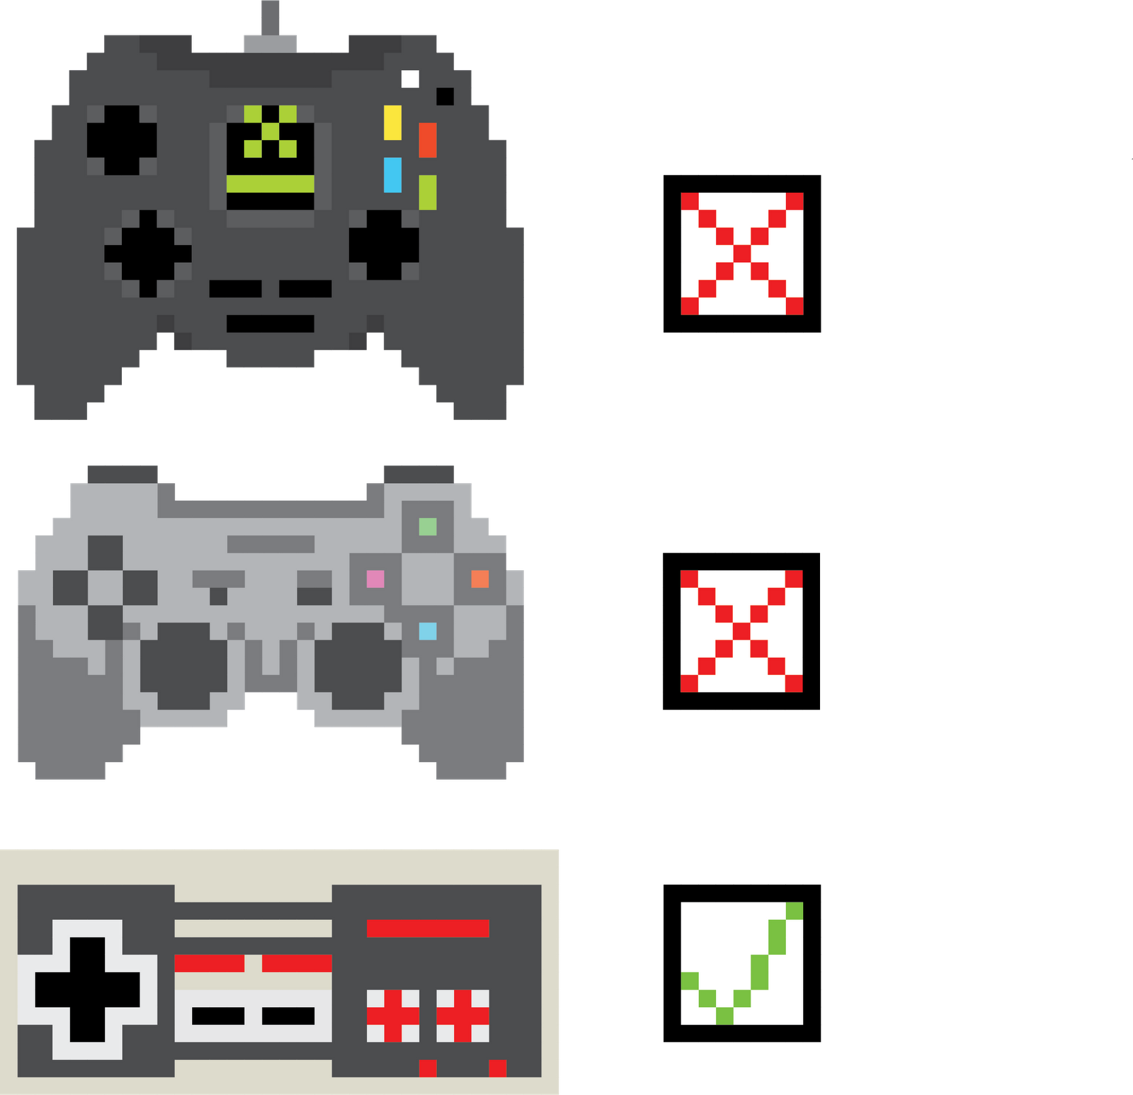


Introduction
Method
Results
Conclusion

Slide 3


Introduction
REINFORCEMENT LEARNING
State,Reward
ENVIRONMENT
Action

Slide 4
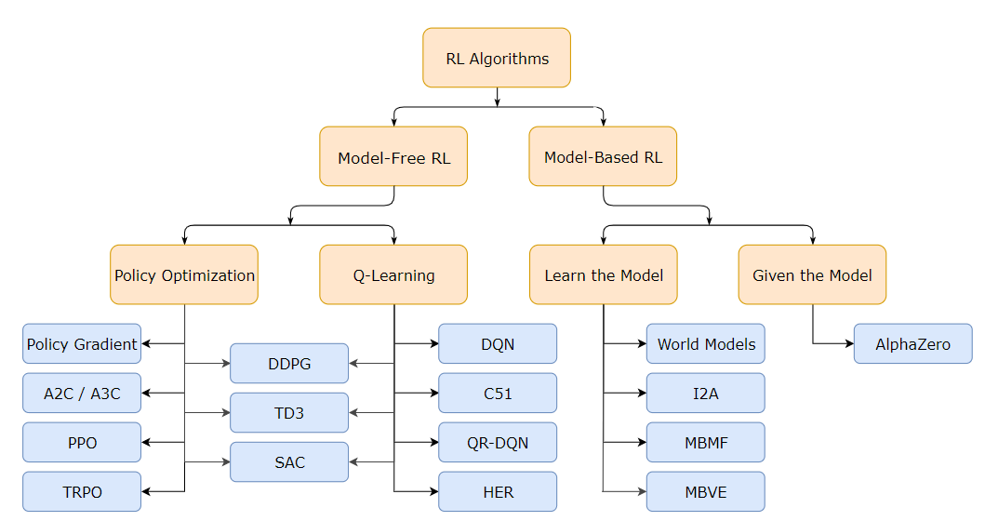
Introduction
REINFORCEMENT LEARNING

Slide 5

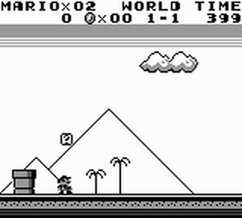
Method
ENVIRONMENT
REWARD
World level
coins
lives_left
score
level_progress
level_progress_max

Slide 6
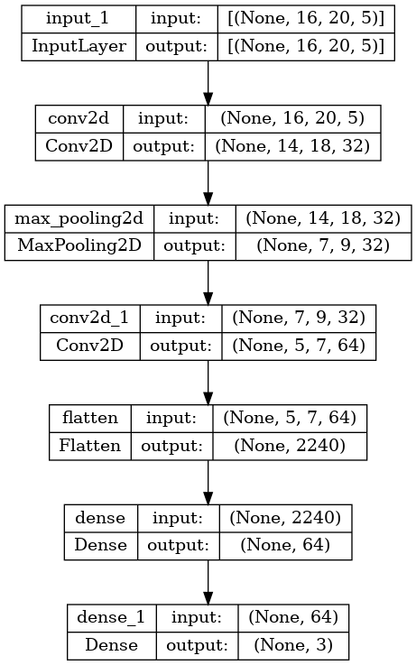
Method
AGENT

Slide 7
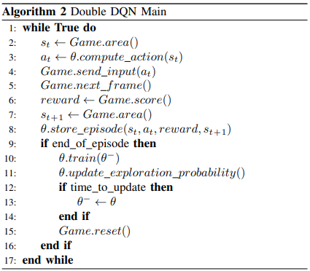
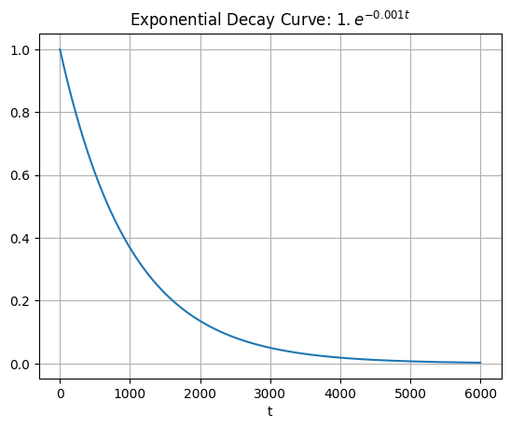


Method
MEMORY BUFFER
IMPLEMENTATION
LOSS
$$Q$$
$$Q^{∗}$$

Slide 8
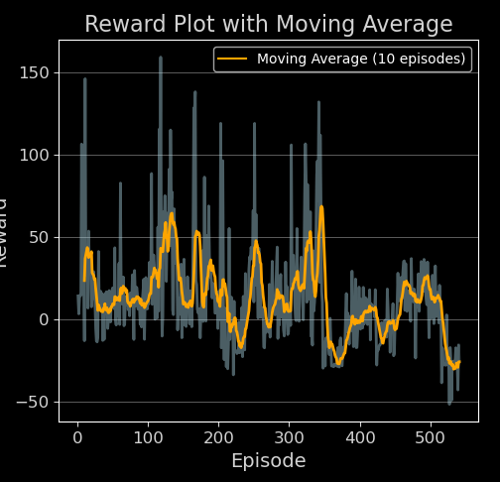
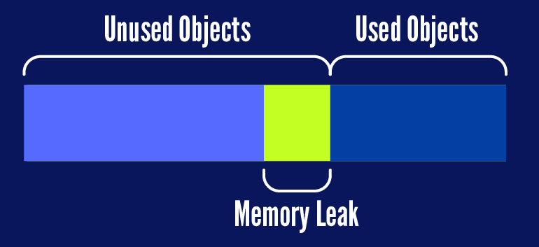
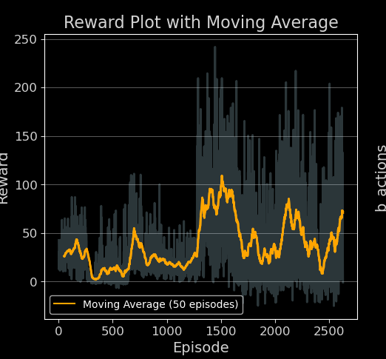

Results

Slide 9
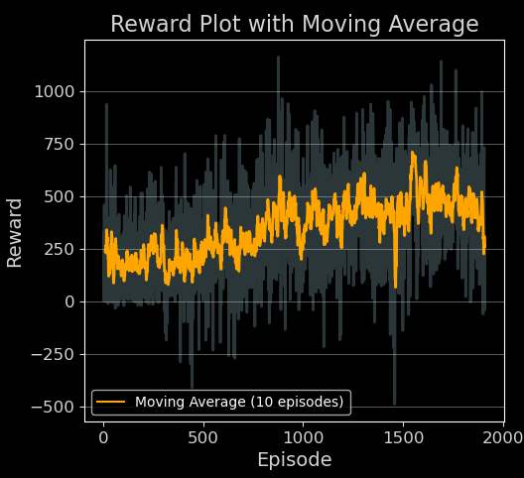
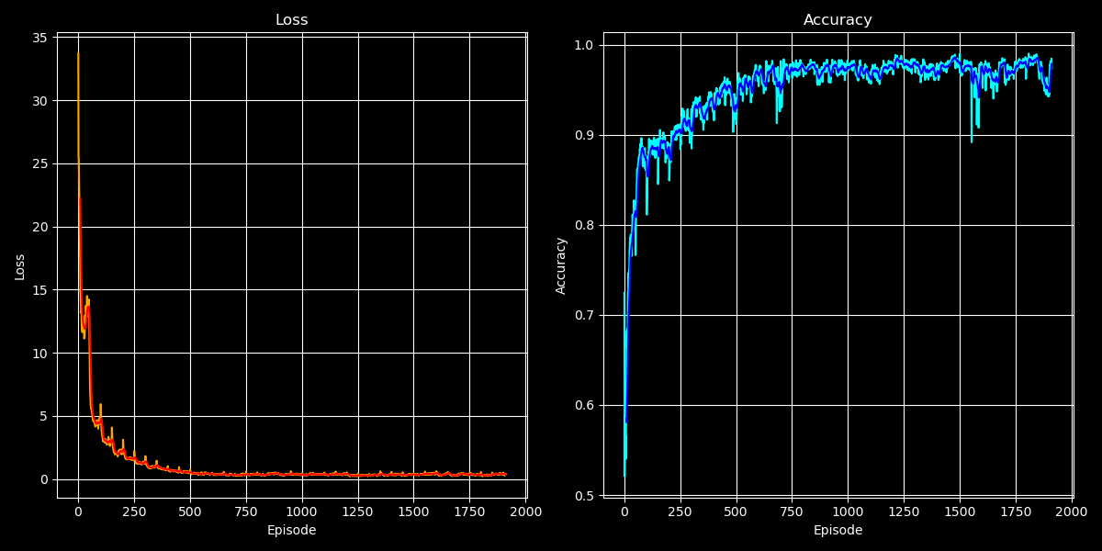
Results

Slide 10
Multi-process
shared θ
^{CHILD PROC :} Worker 1
^{CHILD PROC :} Worker 2
shared XP
^{PARENT PROC :} Learner
^{CHILD PROC :} Worker N

Slide 11
Conclusion
Foundational understanding of reinforcement learning (DQN and DDQN).
Improvements in AI gameplay performance.
Parameters like batch size, discount factor, and exploration rate significantly impact the learning process.
Model behavior highly depends on reward function.

Slide 12


